Slide 1

Hemodynamic Group
Update
Co-chairs: Souvik Mitra & Amish Jain

Slide 2
Summary of activities – Year 1
February 2020
May 2020
July 2020
February 2021
Established during the last EPIQ meeting
First teleconference
Working groups:
Group leads assigned
Tentative teams formed
Preliminary work completed for 3 practice bundles
Gauging interest across the country in joining the hemodynamic group
Brainstorming potential topics that may benefit from evidence-based practice bundle
1 lead neonatologist
3-4 neonatologists (mix of senior and early career faculty)
1-2 neonatal trainees/NNPs
Patient identification and management pathways
Hypotension in PPHN
Hypotension in septic shock
PDA Management
Hypotension management
Patient identification and management pathways
Conservative management guideline
Procedural closure
BP normative values
Transitional hypotension
Hypotension in septic shock and PPHN

Slide 3
Working subgroup teams
PDA Management
Patient identification and management pathways | Audrey Hébert Bonny Jasani Michael Castaldo Christine Drolet Caio Barbosa Danielle Styranko Lead – Souvik Mitra
Conservative management guideline | Amouchou Soraisham Kumar Kumaran Souvik Mitra Lead – Gabriel Altit
Procedural closure | Joseph Ting Amneet Sidhu Walid El-Naggar Lead – Dany Weisz
Hypotension Management
BP normative values | Muzafar Gani Abdul Wahab Nadya Ben Fadel Walid El-Naggar Debbie Fraser Maher Shahroor Nicole Kjartanson Lead – Yasser Elsayed
Transitional hypotension | Abbas Hyderi Amneet Sidhu Soume Bhattacharya Lead – Amish Jain
Hypotension in septic shock and PPHN | Soume Bhattacharya Deepak Louis Kumar Kumaran Leads: Audrey Hébert & Ashraf Kharrat

Slide 4
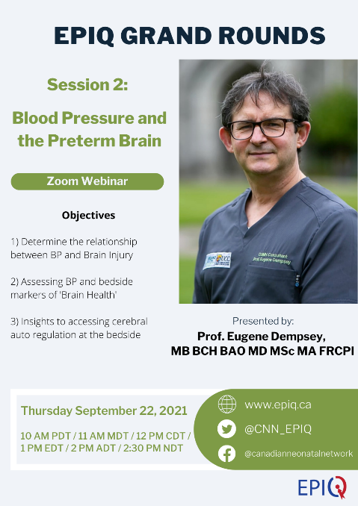
Summary of activities – Year 2
February 2021
August 2021
September 2021
December 2021
EPIQ Hemodynamic group meetings – extensive discussion, feedback & finalization of 3 bundles:
Patient identification and management pathways
Hypotension in PPHN
Hypotension in septic shock
Bundles posted on the EPIQ website
Preliminary work completed for:
BP normative values
guideline

Slide 5
Summary of activities – Year 3
January 2022
September 2022
January 2023
BP normative values guideline published
Taskforce to create a list of hemodynamic data variables to be added to CNN – led by Dr Soume Bhattacharya
Taskforce to create compliance checklists for existing hemodynamic bundles – seeking volunteer(s) to lead this project
Management of suspected septic shock bundle updated by Dr Ashraf Kharrat
Preliminary list of variables created to be proposed to CNN

Slide 6
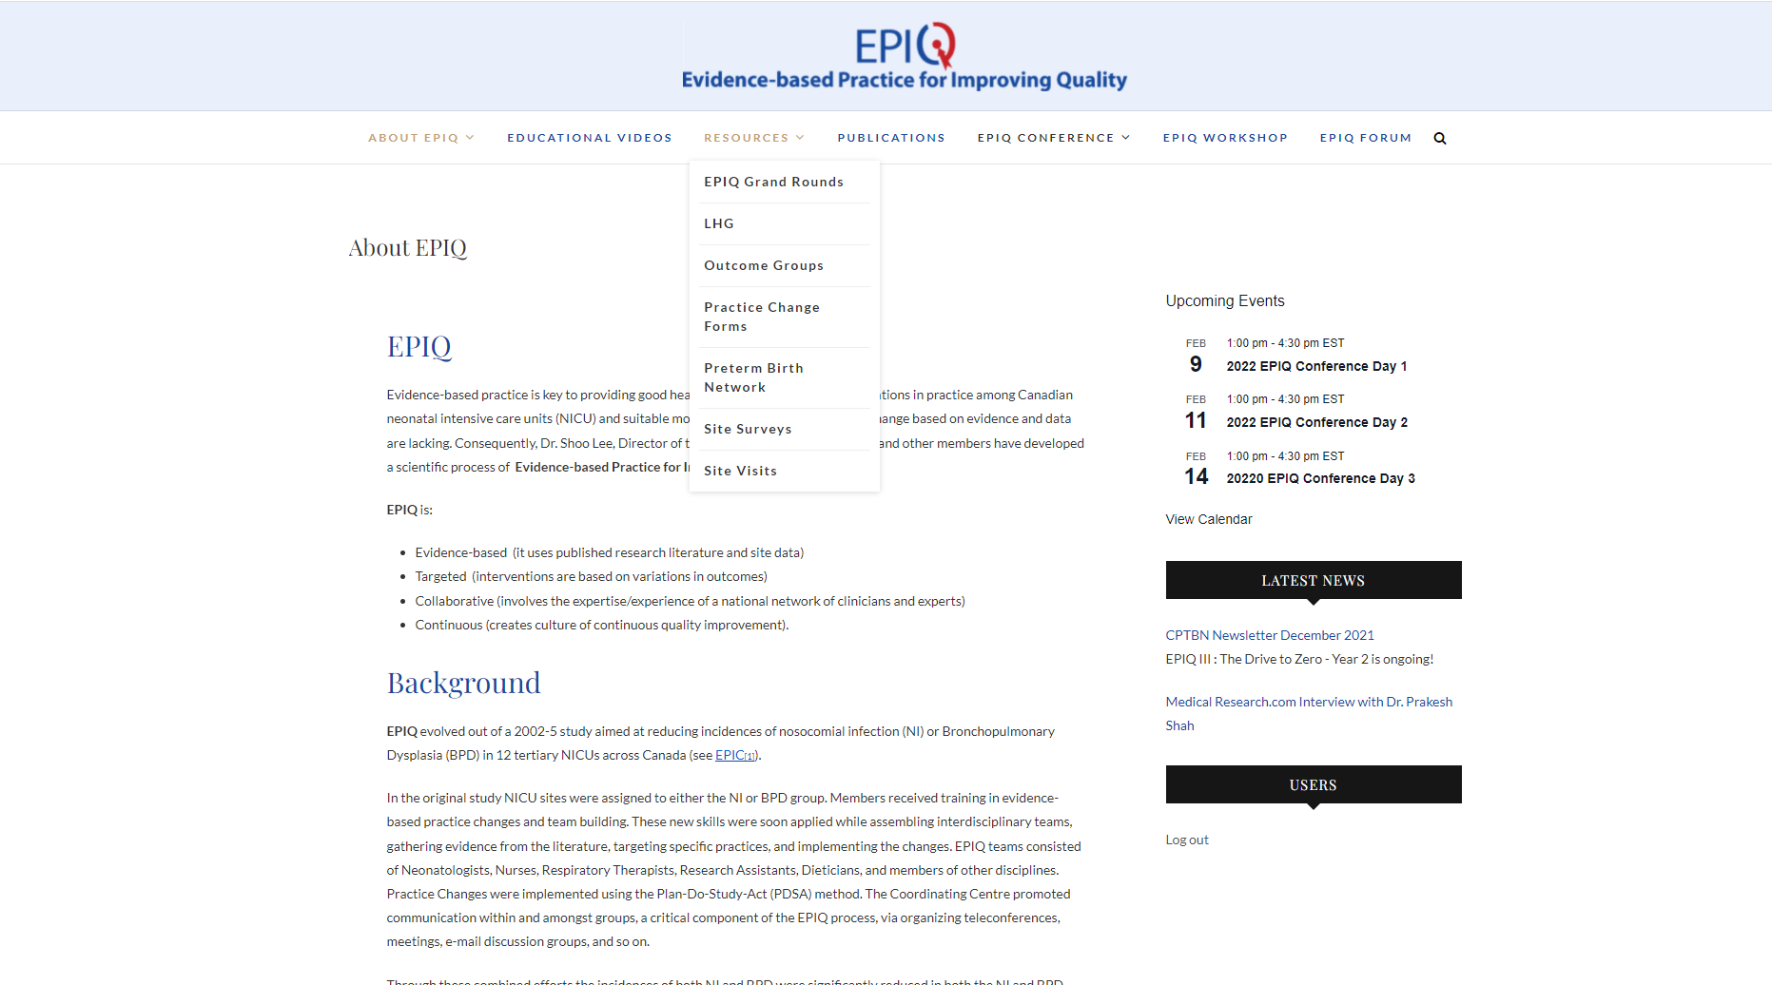
Where do we find the bundles?

Slide 7
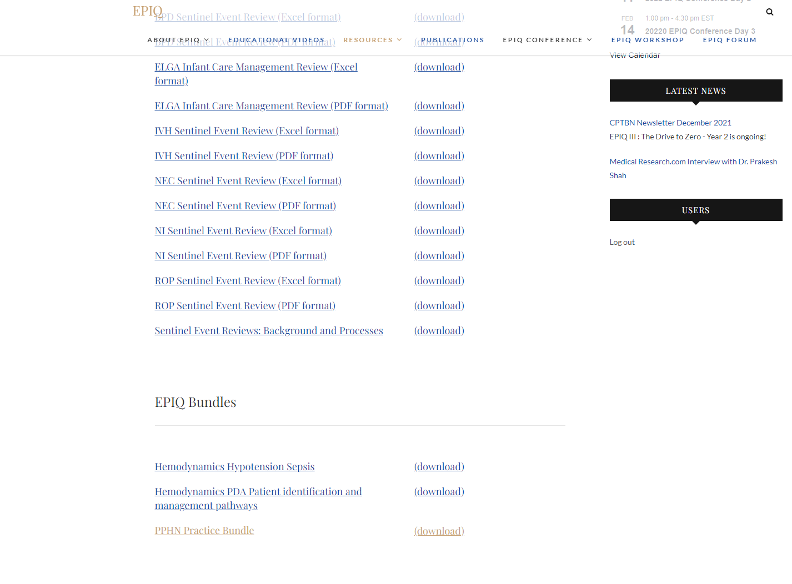

Slide 8
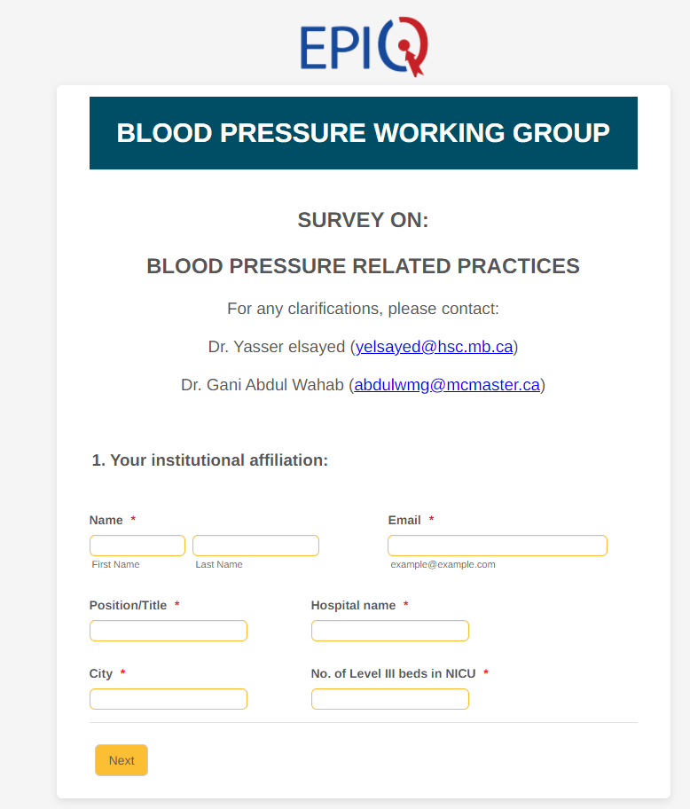
Development of evidence-based practice bundles
Identify priority questions within each subgroup
[Conduct formal/informal surveys (if required)]
Each member tasked with summarizing available evidence for each particular question
Collate and discuss all summarized evidence
Discuss quality of evidence (and if possible use established methods to assign certainty of evidence, eg, GRADE)
Finalize the practice bundle within their own subgroup prior to presenting it to the larger group

Slide 9
PDA Patient identification and management pathways in preterm infants
Priority Questions
Prophylactic cyclo-oxygenase inhibitor therapy
‘Routine echocardiographic screening’ vs ‘echocardiography only when clinically indicated’ to diagnose of hs-PDA
When should a PDA be treated with pharmacotherapy?
What is the pharmacotherapy of choice for treatment of hs-PDA?
Repeat courses of pharmacotherapy
Feeding during treatment

Slide 10
Principles of management of suspected septic shock
Monitoring of clinical variables
What clinical variables should be monitored?
What BP thresholds should be used?
Should NIRS be used?
Fluids
What type of fluid?
Volume of each bolus
Max volume of initial resuscitation
Vasopressor/Inotrope
When to consider
How to decide on vasopressor vs inotrope
Recommended first line vasopressor/inotrope
Starting dose, titration, monitoring parameters for each
Adjunct therapies
Role of corticosteroids
Role of bicarb infusion
Role of TNE

Slide 11
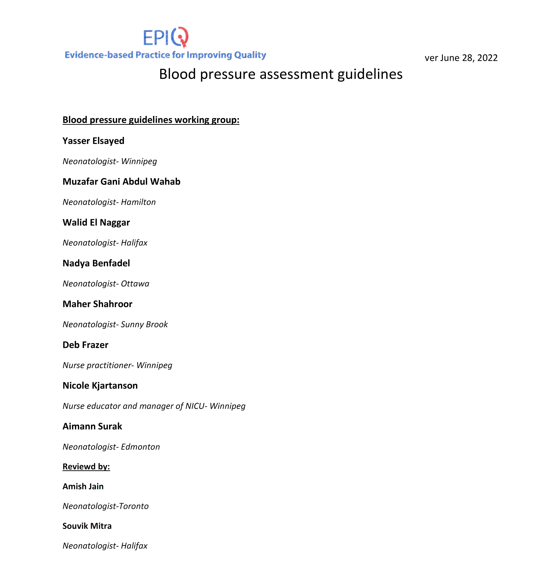
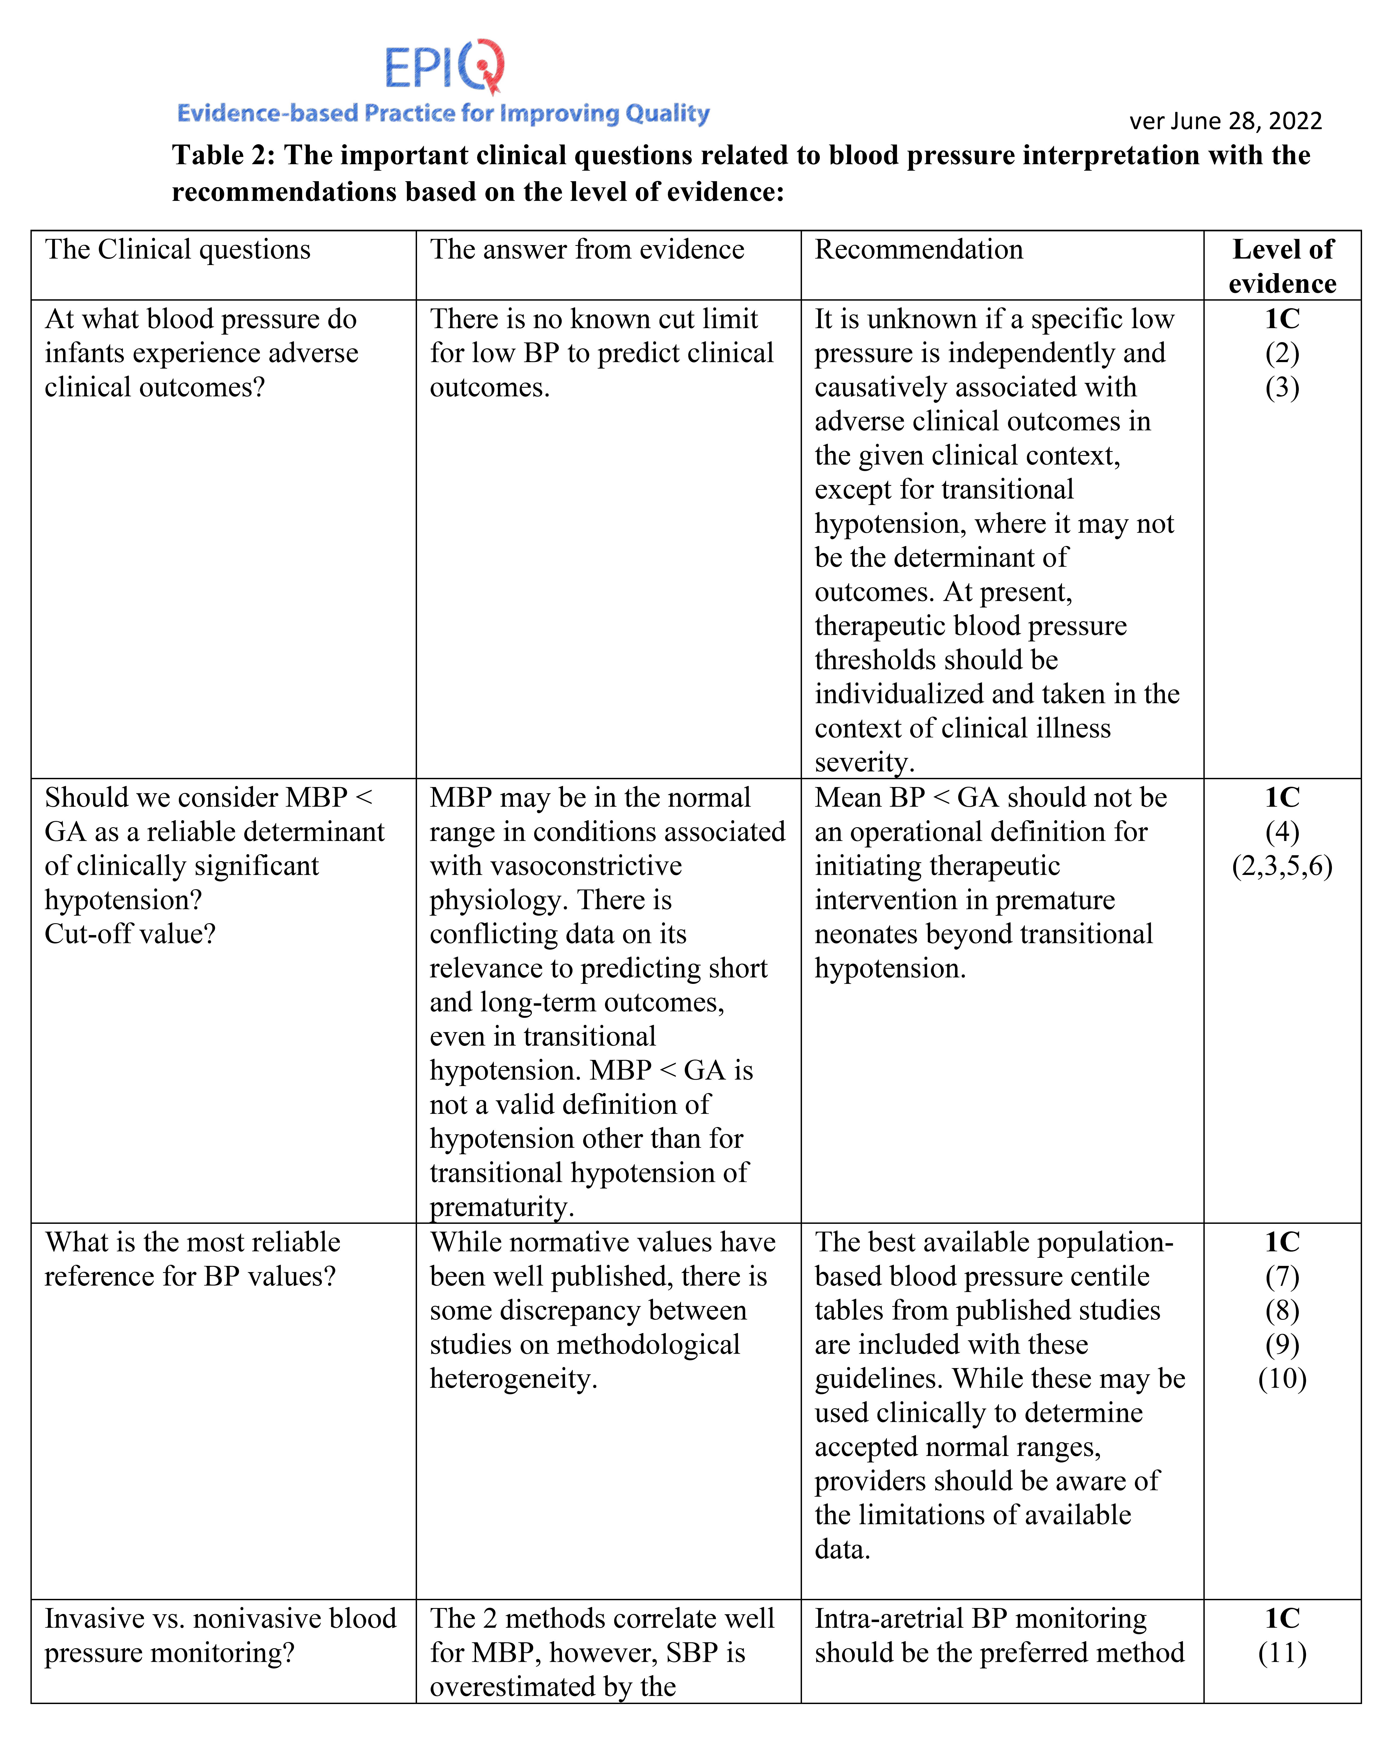

Slide 12
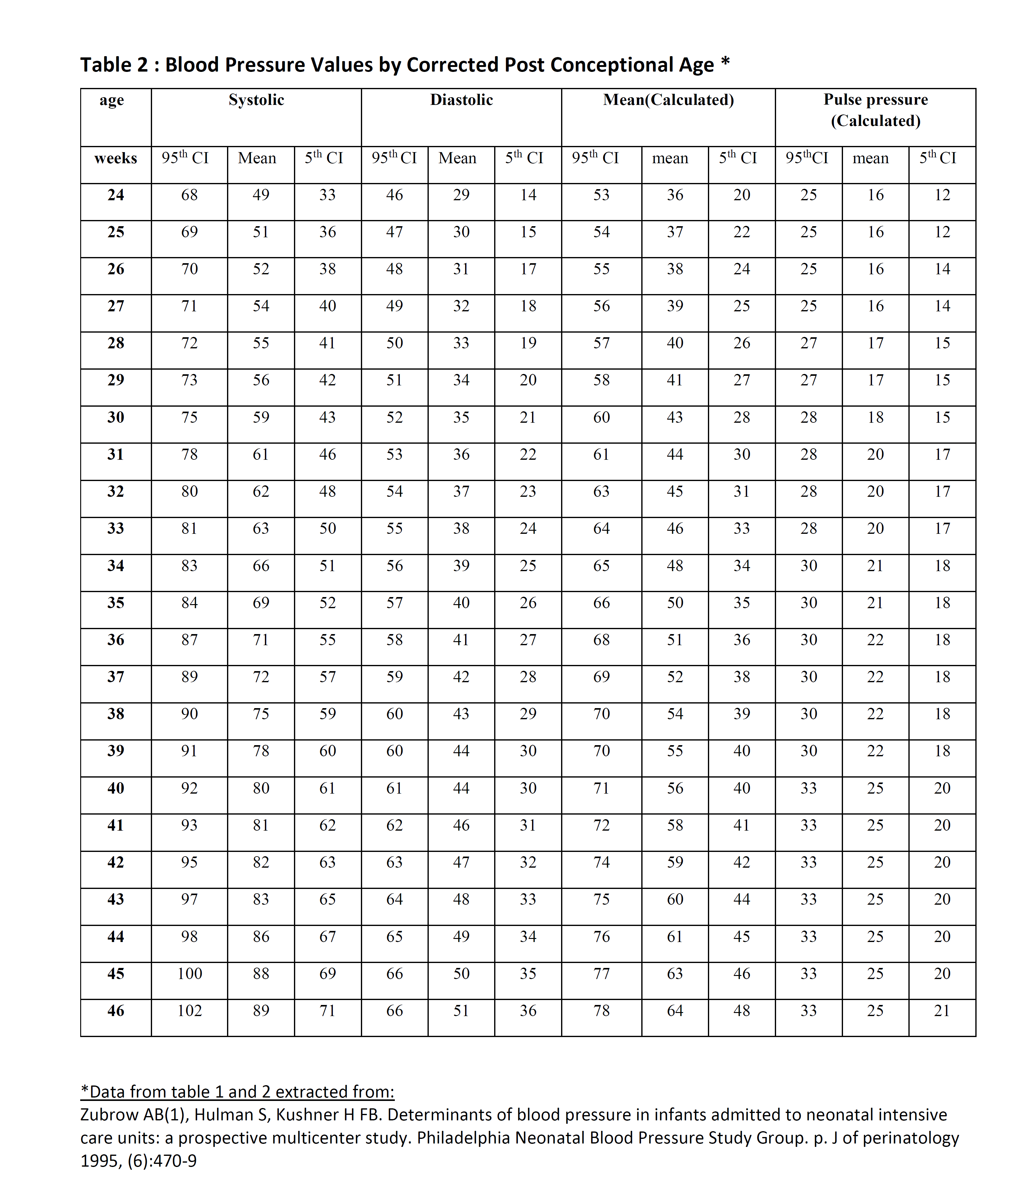
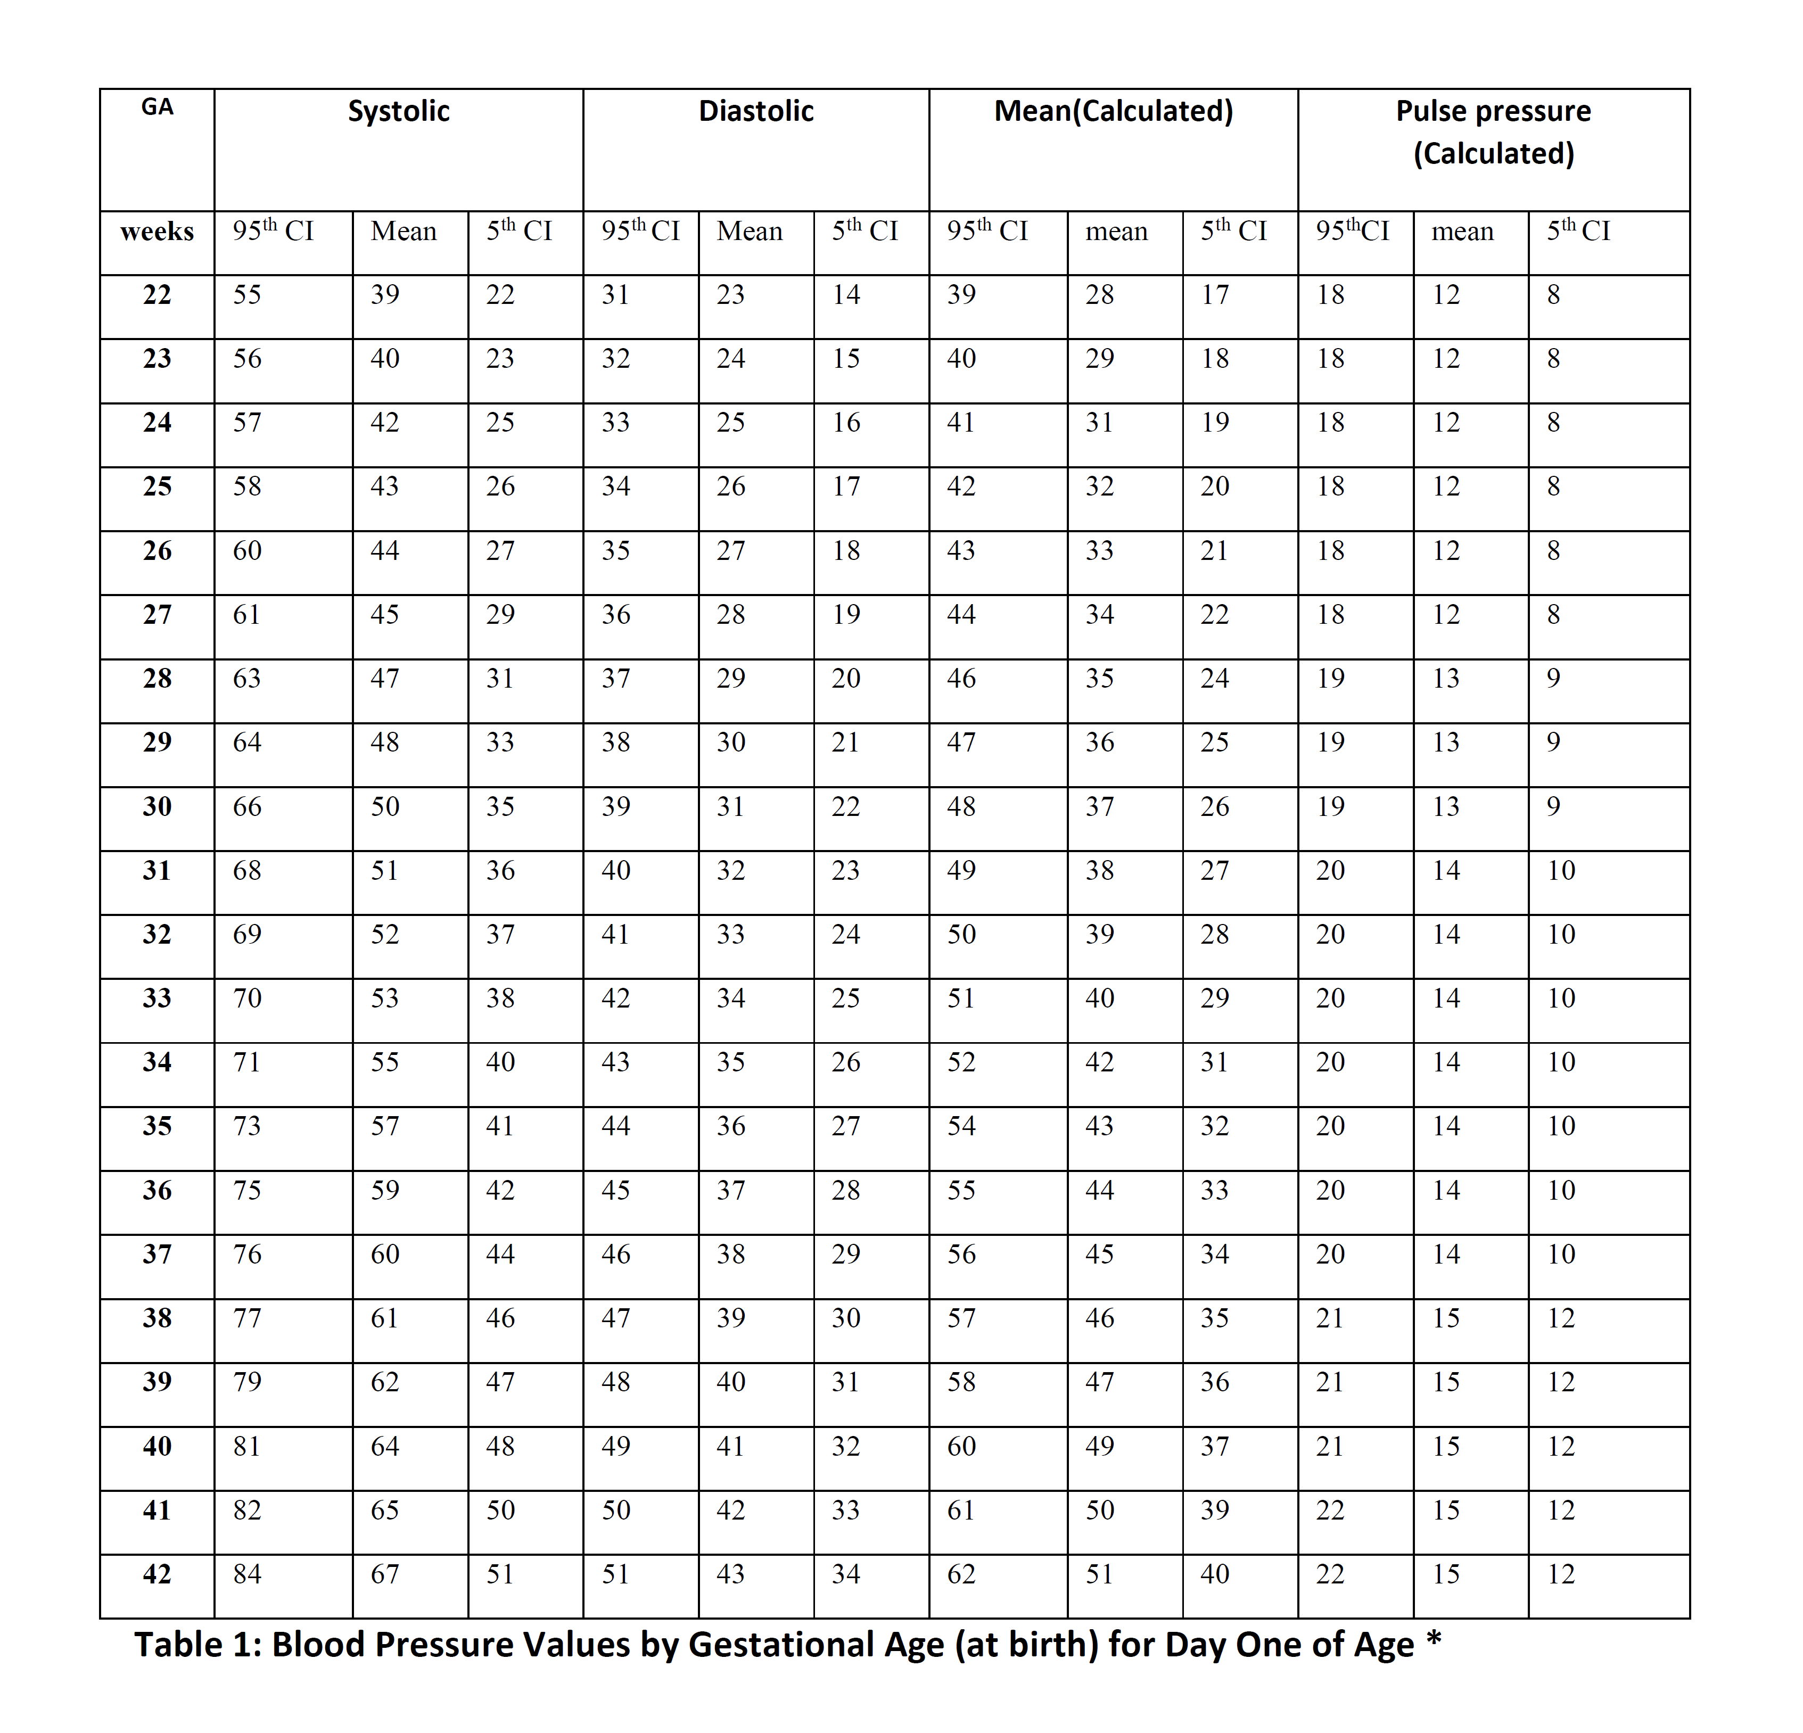

Slide 13
Future Plan
Encourage adoption of bundles approved by the EPIQ hemodynamic group
  Create compliance checklists
  Local centers to report on adherence and experience in adopting the bundles at the 2024 EPIQ conference
Impact of use of hemodynamic bundles on clinical outcomes – 2025 EPIQ conference
Seek opportunities for national-level pragmatic clinical studies to test the effectiveness of practice bundles
  Comparative effectiveness research projects
  Cluster RCTs

