Slide 1
EPIQ FUTURE PLANS

Slide 2
EPIQ - 4
2018-2022
What next?

Slide 3
Aspects of EPIQ 4
EPIQ 4
CQI-PDSA cycles
2-3/year
Comparative studies
Sentinel Event Review
VIRTUAL
Site visits
Training/
Standardization
AI integration
Parent engagement
System/ resource level QI

Slide 4
Comparative studies
NIPPV vs CPAP rolled out
PDA management strategy
Antibiotic stewardship project
Resource utilization project

Slide 5
Currently active projects
Neonatal EPIQ
Parent-EPIQ
Perinatology – connect with your OBGYN/MFM colleague

Slide 6
Let’s work together…..
Perinatal health
Brain health
Gut health
Lung health
Infection prevention (Immune health)
Cardiovascular hemodynamics
Family health
Inter-linked improvement groups

Slide 7
QI is not a short term measure
We all come to work to
To provide excellent care to our patients and
To improve the care that we provide
Don Berwick
Improving medical care will require systems redesign
Every system is perfectly designed to get the results it gets
Paul Batalden

Slide 8
For QI to work
We all know E = MC²
Similarly for QI
E (Effectiveness) = QA²
62% of quality efforts fail from lack of attention to the cultural and people sides of change – the “A”
E (Effectiveness) = Q (Accountability x Acceptance)

Slide 9
Why am I talking about this now?
We need sustainability plan/discussion
What –
Technical knowledge to understand variation, study system, build learning, determine best possible interventions
How
Implement strategies
Who
Power of all of us (HCW and parents)
Why
Motivation of people

Slide 10
Going forward:
Please join 3-monthly teleconferences of groups
Help updating practices bundles
Send your protocol and checklists
If any objection to putting your poster on OPEN website, let us know
If any topic that we should cover at next year’s meeting – please let us know

Slide 11
EPIQ Education Program is looking for new steering committee members Khalid Aziz & Jehier Afifi
Notes:
Thank you very much for the introduction. The purpose of this presentation is to support and maintain our facilitator base. I will start with a brief presentation of the background of the EPIQ workshop.

Slide 12
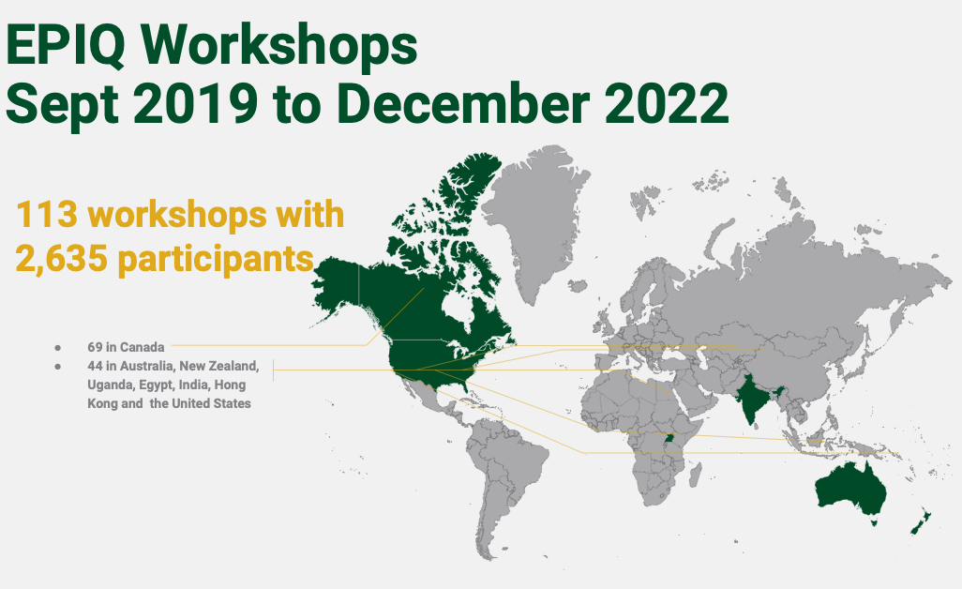
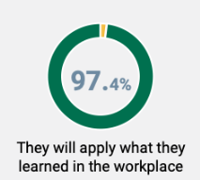
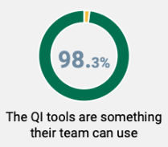
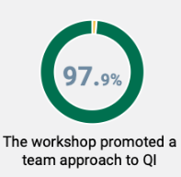
Current workshop activity

Slide 13
EPIQ Education Program Steering Committee
Practice and implementation
Research and evaluation
EPIQ internal administration
Educational content and delivery
Facilitator support
Marketing
1. EPIQ Education Program is owned and managed by the Canadian Neonatal Foundation
2. EPIQ Education Program Steering Committee is informed by 6 primary drivers
3. EPIQ workshops, participants, and facilitators are registered by the Office of Lifelong Learning and the University of Alberta

Slide 14
Looking for 2 EPIQ-EPSC members
Practice and implementation
Research and evaluation
EPIQ internal administration
Educational content and delivery
Facilitator support
Marketing
Whom do we need?
Passionate about QI or QI expertise
OR experience in KT/implementation research or education
AND willingness and ability to work with a small group on any or all the 6 primary drivers
What is the commitment?
6-10 virtual committee or sub-committee meetings per year
Becoming an EPIQ facilitator
Volunteership (for CNF, a registered Canadian charity)
Send a one pager explaining why you would be suitable for this role: khalid.aziz@ualberta.ca or Jehier.Afifi@iwk.nshealth.ca

Slide 15
Should we engage in another registry based CER?
We need you to bring ideas
Individual
EPIQ health groups
Few hospitals

Slide 16
Any other suggestions/thoughts?

Slide 17
Acknowledgement
CNN site investigators
EPIQ site investigators
iNeo Investigators
CNN Executive Committee
EPIQ Steering committee
CNN abstractors
Patients and families
Canadian Premature Babies Foundation
Individual hospitals and Foundations
CIHR and several other funding sources
Mother-Infant Care Research Center, Toronto
Mount Sinai Hospital

Slide 18
Special thanks
Organization
Priscilla
Tasnim
Technical support
Nevetha
Sonny
Other support
Joseph
EPIQ group leads
All sites
Moderators
Sponsors
Farid
Redtree
Pheedloop
Medela
Aerogen
Prolacta
Masimo

Slide 19
Thank you

